Slide 1
Artificial Intelligence (Machine Learning & Deep Learning)
{
Advanced OOP: Polymorphism, Abstraction, & Magic Methods
}
...

Slide 2
{
..
"The most dangerous phrase in the language is, 'We’ve always done it this way.'" – Grace Hopper
(Computer Science Pioneer & inventor of the first compiler)
}
..

Slide 3
Contents of Day 8
Conditional Execution & Loops
Recap & introduction | Review of Inheritance, Encapsulation (Private/Public), and Composition.
Core Thoery | • Polymorphism & Dynamic Polymorphism. • Operator Overloading & Magic (Dunder) Functions. • Abstract Classes, Data Classes, and Empty Classes. • Keyword Arguments (**kwargs)
Lab Practice | Practical coding tasks implementing method overriding, magic functions, and data classes.
Advance Lab | Building a strict AI pipeline template using Abstract Base Classes.
Wrap-up & Q&A | Debugging OOP logic, resolving MRO conflicts, and preparing for tomorrow's topic: Descriptive Statistics and Probability.
Important: Use of AI for solving given task is not allowed. Cellphones must be put on silent.

Slide 4
Today Objective - Flexibility & Strict Rules
Yesterday, we built the (Classes and Inheritance).Today, we are learning how to make our code both Flexible (Polymorphism) and Strict (Abstraction).
Why it matters in AI: When you build an AI pipeline, you want to be able to plug in 10 different types of models (Neural Networks, Decision Trees, etc.) without rewriting your main code. Polymorphism lets you treat them all exactly the same, while Abstraction forces your teammates to follow your architectural rules so they don't break the system.
}
..

Slide 5
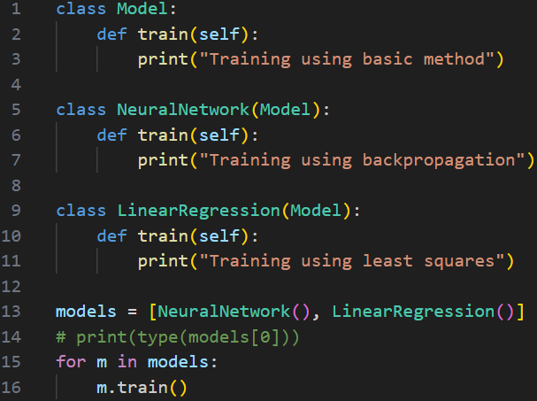
Core Concept (Definition & Rules) Polymorphism allows different classes to use the same method name but with different implementations.
🔹 Types of Polymorphism in Python
1. Compile-time (Not fully in Python)
Method overloading (Python doesn't support directly)
2. Runtime Polymorphism (IMPORTANT)
Method overriding (main concept in Python OOP)
Polymorphism The word "polymorphism" means “same name, many forms", and in programming it refers to methods/functions/operators with the same name that can be executed on many objects or classes. i.e len() func run for (string- return len)(tuple-return len)(dictionaries-return keyLenth)
Dynamic Polymorphism (Runtime Polymorphism) When a child class overrides a method of the parent class, and the method executed is determined at runtime based on the object type.
Polymorphism & Dynamic Polymorphism
AI Application:
Calling model.train() on a Neural Network vs. a Linear Regression model. They both execute "train", but the math they do inside is completely different.

Slide 6
Core Concept (Definition & Rules)
Definition:
Magic Functions (Dunder Functions)
Special predefined methods in Python that begin and end with double underscores (e.g., __init__, __str__, __add__). They are called internally by Python to perform built-in operations.
Magic methods special methods hote hain jo Python objects ko built-in operators aur functions ke sath kaam karne ki ability dete hain.
The Analogy: The "Under the Hood" wiring. When you type print(my_object), Python secretly goes under the hood and calls my_object.__str__(). They are called "Magic" because you usually don't call them directly; Python just magically runs them for you when you use standard symbols.

Slide 7
Core Concept (Definition & Rules)
Operator Overloading
Operator overloading means redefining the behavior of standard operators (like +, -, *) for user-defined classes.
Definition:
Giving extended, custom meaning beyond the predefined operational meaning to operators like +, -, *, or ==.
Example: You already know what + does to numbers (5 + 5 = 10) and strings ("A" + "B" = "AB").
Operator Overloading lets you teach Python what + means when you try to add two custom AI Dataset objects together. Should it merge the files? Should it crash? You get to decide!

Slide 8
Core Concept (Definition & Rules)
Definition:
Abstract Classes & Methods
An abstract class cannot be instantiated directly. It contains abstract methods (methods declared but containing no implementation logic). Any Subclass inheriting from it must provide the implementation for those methods.
AI Application:
Creating a base AIEngine class that forces every developer on your team to write a clean_data() method before they are allowed to train a model.

Slide 9
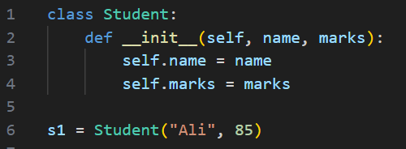
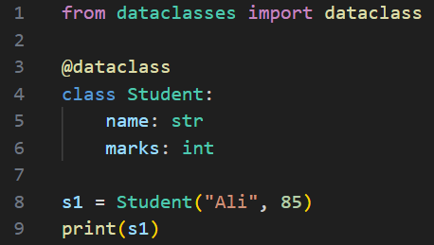
Core Concept (Definition & Rules)
Definition:
Data Class & Empty Class
Empty Class: A class with no attributes or methods, created using the pass keyword. Used as a placeholder for future implementation.
Data Class: A decorator (@dataclass) introduced in Python 3.7 designed strictly to hold state/data rather than complex logic, automatically generating __init__ for you.

Slide 10
Core Concept (Definition & Rules)
Definition:
Keyword Arguments (**kwargs)
Passing arguments to a function or class by explicitly stating the parameter name, allowing you to pass a variable number of named arguments wrapped into a dictionary.
*args → collects extra positional arguments stored as a tuple inside the function
**kwargs → collects extra keyword arguments Stored as a dictionary inside the function

Slide 11
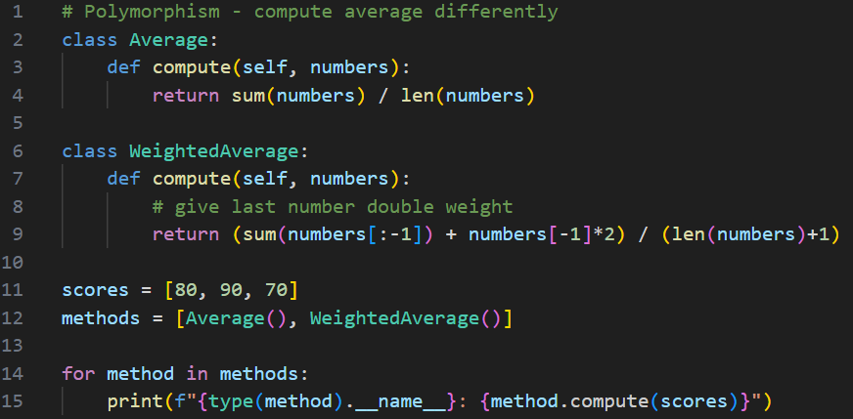
Practical exercise 01
Lab Task 1 – # Polymorphism - compute average differently
*

Slide 12
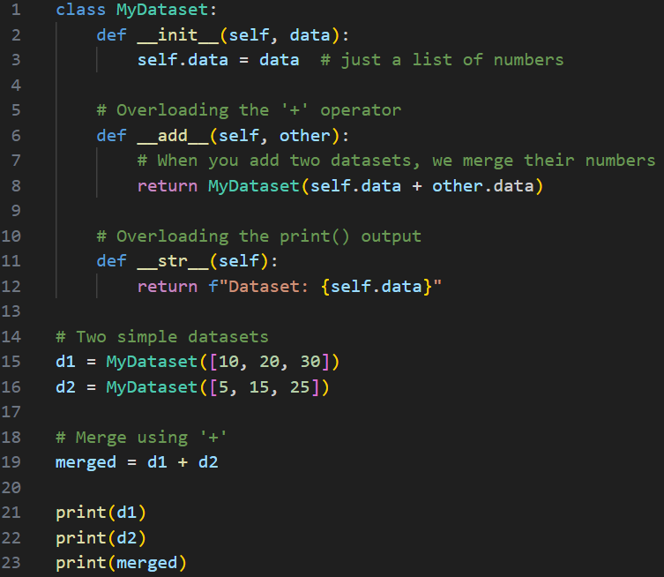
Practical exercise 02
Lab Task 2 – Magic Functions (Dunder Functions) Operator Overloading
*

Slide 13
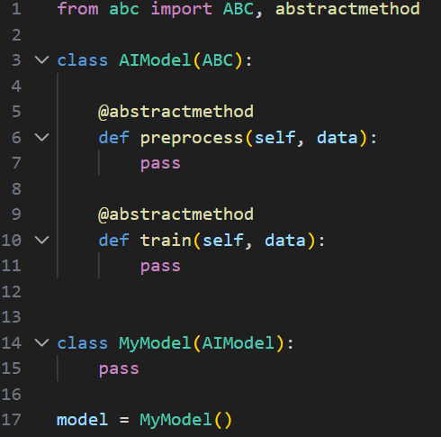
Practical exercise 03
Lab Task 3 – Abstract Method
*

Slide 14
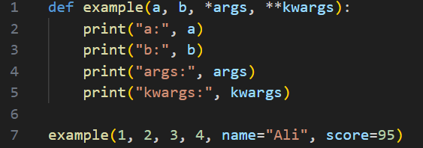

Practical exercise 04
Lab Task 4 – *args & **kargs
*

Slide 15
Thank You for Your Focus Today!
What was the most confusing part of today's lab?
Waleed Khan (Robotics Engineer | Senior Python Developer)
Email: 0xcloudcoder@gmail.com Contact: +923126008702
}
*

